Slide 1

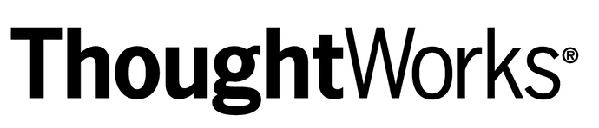

World visitz – Selling the leadership team
Part 1(AGILE FOUNDATIONS): how world visitz can benefit from agile software development
Part 2(AGILE ONBOARDING): the optimal agile framework for wolrdvisitz

Slide 2
How agile benefits an organization
AGILE is an extremely flexible & powerful tool for software development. It does provide process & efficiency benefits to the entire development team and it also provides business-case benefits to the organization as well. The most common pitfalls of any product development team are being addressed & dealt with in a very flexible and systematic way. The following are 8 key benefits of the Agile Framework:
1. IMPROVED QUALITY | Breaks down projects into manageable units, enables a team to focus on high quality development, testing & collaborationd
2. FOCUS ON BUSINESS VALUE | An increased focus on business-strategic values. Involves all/most of stakeholders in the development process. Enables the team to understand the most vital aspects & focuses on the most important issues/ topics
3. FOCUS ON USERS | Utilizes user-stories with business-focused acceptance criteria. Provides an opportunity to beta-test the software
4. STAKEHOLDER ENGAGEMENT | Involves different types of stakeholders during different iterations and different steps of the project. Promotes high degree of collaboration. Provides more opportunities for the team to grasp the business values.
5. TRANSPARENCY | A unique opportunity for both clients & customers to be involved throughout the project. Includes prioritizing features, iteration planning & review sessions.
6. EARLY & PREDICTABLE DELIVERY | An opportunity to release or beta test a software earlier than planned, if there is sufficient business value.
7. PREDICTABLE COSTS & SCHEDULES | Improves decision-making about the priority of features and the need for additional iterations.
8. ALLOWS FOR GROWTH & CHANGE | Provides an opportunity to constantly refine & reprioritize the over-all product backlog. New backlog items can be planned for the next iterations.
Notes:
Agile has absolutely a lot of benefits to give to any organization. AGILE is an extremely flexible & powerful tool for software development. It does provide process & efficiency benefits to the entire development team and it also provides business-case benefits to the organization as well.
I’ve outlined the 8 key be

Slide 3

Differentiating agile from waterfall method
 | AGILE | WATERFALL
1. PROCESS APPROACH | Very Flexible | Structured, Very Rigid
2. ARCHITECTURAL PROCESS | Very Flexible | Structured, Very Rigid
3. TESTING PHASES | Allows in updates in all phases | Only after the build phase
4. DEVELOPMENT CYCLES | Multiple Sprints/ Different Iterations | Only one cycle
5. NUMBER OF PHASES | Multiple (depending on needs) | Only one
6. STRUCTURE OF DEVELOPMENT | Extremely Flexible | Very strict adherence to step-by-step process
7. SITUATION IDEAL TO USE | Processes involving constant changes | Projects that have VERY CLEARLY defined set of tasks
Notes:
Agile has a LOT of differences and advantages over the traditional waterfall method.
Some of these are:
Agile being more flexible and non linear
Agile having ongoing iterations
Agile allows testing in various phases and is non strict
There is more than 1 development cycle in Agile
Sprints or phases are part of Agile. Waterfall only has 1
Agile is definitely non- stringent and strict as oppose dot waterfall
Agile is extremely ideal ad beneficial to tasks & processes that involves constant changes; such as our Worldvisitz project.

Slide 4

Presenting The Agile Manifesto : 4 Values & 12 Principles “It is BETTER to build a SUCCESSFUL PRODUCT than To build a product SUCCESSFULLY”
The Agile Manifesto has 4 main values that it lives by. Practitioners of this framework are highly encouraged to utilize these methods in real-life business cases.
1.‘Individuals and interactions over process and tools.’
It highly suggest that we should focus more on our people, the entire staff that is responsible for creating and eventually launching the ‘Worldvisitz App’ soon. This step states that our focus should be on competent personnel and that ongoing communication is key. Processes and tools are only given importance if they are helping the team’s performance.
2. ‘Working Software Over Comprehensive Documents.’ Traditional methods of project / product management gave a lot of emphasis on a lot of documentation. Some of these are features, specification, layouts, requirements, test cases, etc. This results in an outdated documentation which may not be even needed. This means a lot of wasted time , energy and other resources.
The Agile Manifesto highly favors feedbacks from working or functioning software. All the basic features should be created first, then be given to the end users & stakeholders. The feedback received from the users would then be used for further development & improvement of the Worldvisitz’ app prototype.
Notes:
The Agile Manifesto is a complete representation of the entire AGILE FRAMEOWRK. It acts as both a ‘standard manual’ and as a ‘guide’ where practitioners and Agile experts can all use a the main reference. Agile has 4 Values and 12 Principles that also acts not just as ‘commandments’ but also as a ‘structural guide’ for the Agile team. Just by browsing at these 4 values and 12 principles, it could automatically be inferred that Agile has way more advantages over Waterfall. This is one of the many reasons why I chose Agile over the traditional Waterfall method.

Slide 5
3. ‘CUSTOMER COLLABORATION OVER CONTRACT NEGOTIATION.’
The traditional method was very linear : Contract negotiation > Further Changes > Project Completion.
This simply meant that user and customer feedback was usually neglected during the entire SDLC ( Software Development Life Cycle). Agile prefers to have a constant feedback all throughout the product development cycle. This ensures that any changes or upgrades made were relevant. Whatever is being developed is also being seen by the customer/ stakeholders/ end users.
4. ‘RESPONDING TO CHANGE OVER FOLLOWING A PLAN.’
* The shortness of iteration means priorities can be shifted & adjusted regularly. Features could be added constantly into the next iteration.
Notes:
Customer Collaboration is given more importance than contract negotiation in Agile
Also, Agile highly prefers the flexible approach of ‘responding to change’ as opposed to simply following a strict plan.

Slide 6
The Agile Manifesto has 12 main principles that it lives by. Practitioners of this framework are highly encouraged to utilize these methods in real-life business cases.
‘Our Highest Priority is to Satisfy the Customer Through Early & Continuous Delivery of Valuable Software.’
At the end of the day (lifecyle), what matters is a properly working Worldvisitz Mobile App that is fully functional and integrates with the necessary back end. This is why there is heavy emphasis on early feedbacks and corrections.
2. ‘Welcome Changing Requirements, Even Late in Development. Agile Processes Harness Change for the Customer’s Competitive .’
End users learns more about the end product by having constantly seen the potential app. They also get a ‘feel’ of the end result.
3. ‘Deliver Working Software Frequently, From A Couple of Weeks to A Couple of Months. With A Preference to the Shorter Timescale.’
Frequent delivery of product is highly encouraged. The more frequent the delivery, it becomes more Agile. Risks are mitigated. We also get faster feedbacks from our stakeholders/customers. This means that changes to the product could be brought in before it’s too late.
Notes:
I’d like to highlight the first 3 Principles of the Agile Framework:
Priority to Satisfy the Customer
Welcoming to changing requirements
Delivery of effective working fotware

Slide 7
Continuation : The 12 principles of agile ( #’s 4 to 6)
4. ‘Business People & Developers Must Work Together Daily Throughout the Project .’
Business and technical aspect are at the same page. This also gives the developers & solutions architects ( if applicable) an ‘end users’ view of the product/ prototype.
5. ‘Build Projects Around Motivated Individuals. Give Them the Environment & Support They Need, and Trust Them to Get the Job Done.’
Motivated staff are highly more likely to get the job done and with BETTER results. A good environment yields superior products.
6. ‘The Most Efficient & Effective Method of Conveying Information to & Within A Dev’t Team is Face-to-Face Communication .’
Written communications and memos are usually filled with ambiguity. It sometimes causes confusion too. Face to face (if non remote nor non distributed) makes product development faster and more precise. If face to face is not possible, as what is happening with our current COVID-19 globally, then tools like Slack, Zoom/Skype/Google Hangouts and JIRA would make this possible.
Notes:
Now I will be summarizing the 4th to 6th principles of Agile:
4. Business People and Tech persons must work hand in hand’
5. Projects should be built around motivated people
6. Face to face communication is the top priority if the entire team is collocated.
** I’d like to point out that due to the ongoing global pandemic, plus some timezone and location differences, only a few members would be having face to face meetings either each other

Slide 8
CONTINUATION: 12 PRINCIPLES OF AGILE (#S 7 TO 9)
7. ‘Working Software is the Primary Measure of Progress .’
Measurement of the product’s over-all improvement should be based on the actual working software. Agile emphasis that:
A software is not finished when it is successfully tested & delivered, it is finished when it is tested & accepted by the end user.
8. ‘Agile Processes Promote Sustainable Development . The Sponsors, Developers & Users Should Be Able to Maintain a Constant Pace Indefinitely.’
Sustainable development should have a decent pace, just like ‘running a marathon’. Agile emphasizes that this is NOT a sprint. A team should not exhaust their efforts and energies right away. Our team at Worldvisitz should be open and be able to endure the process on a longer timeframe.
9. ‘Continuous Attention to Technical Excellence & Good Design Enhances Agility.’
Our team should be very observant of proper design principles and practices. This is what brings ‘craftsmanship’ into fruition.
Notes:
The 7th to 9th principle of Agile are:
7. The main measure of Progress is a working software
8. Sustainable Development is a priority of Agile
9. Extreme attention 7 focus to technical excellence and good usability (UX/CX) is prioritized

Slide 9
CONTINUATION: 12 PRINCIPLES OF AGILE: #S 10 TO 12
10. ‘SIMPLICITY -- > The Art of Maximizing the Amount of Work Not Done – Is Essential.’
It is highly imperative to keep the process simple. Overly complex code and frameworks would eventually cause confusion. It is much better to have a simple product/ app that lives up to the expectations and serves the customers needs. Contrast this with a product/app that tries to do ‘everything’ but fails in most parts; if not all.
11. ‘The Best Architectures, Requirements & Designs Emerge from Self-Organizing Teams.’
This states that our team should manage associated responsibilities & timelines. Self organizing teams are highly recommended to have a ‘mentor’ ( this person could be 1 of the existing team members). Collaboration, teamwork, competency, motivation, regular growth and commitment are highly encouraged.
12. ‘At Regular Intervals, the Team Reflects on How To Become More Effective, Then Tunes & Adjusts Its Behavior Accordingly.’
Continuous Improvement and productivity is highly encouraged. Agile believes that when a team behaves accordingly and is observant to changes and possible improvements, then the team becomes more effective. Productivity is relatively increased.
Notes:
The 10th to 12th principles of Agile are:
10. Simplicity – to maximize the amount of work not done is given priority
11. Self Organized teams deliver excellent results
12. Team reflections on regular intervals and and behaviour is adjusted accordingly

Slide 10
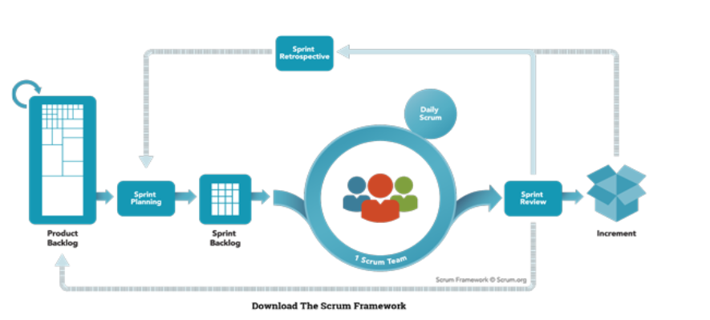
PART 2: THE OPTIMAL AGILE FRAMEWORK FOR WORLDVISITZ (scrum, Kanban & xp)
A BRIEF OVERVIEW OF THE 3 MAIN AGILE FRAMEWORKS:
1. SCRUM
A lightweight, simple to understand and difficult to master framework. Utilized to address complex adaptive problems.
Highly emphasizes simplicity & implements the scientific method of ‘empiricism’. Focuses on people rather than tools and documentations.
Scrum Teams are assigned to the following members: Product Owner, Scrum Master & Development Team Member
Notes:
SCRUM Framework also has events and artifacts attached to it’s framework. The Scrum Events are: Sprint, Sprint Planning, Daily Scrum, Sprint Review & Sprint Retrospective. SCRUM Artifacts are the following: Product Backlog, Sprint Backlog and Increment. I will be giving a very brief summary of each on my next slide.

Slide 11
Scrum events & artifacts
SCRUM EVENTS:
Sprint – No changes are made during the Sprint cycle that may appear to ‘harm’ or endanger the Sprint Goal
Sprint Planning – time boxed to a maximum of 8 hours for 1 month sprint.
Daily Scrum – Focuses on ‘Inspection’ and ‘Adaptation’. Aims to improve communications , eliminate unnecessary meetings and identify obstacles & potential hurdles
Sprint Review - done at the end of a Sprint in order to further inspect if the Product Backlog needs some modifications. The Product Owner explains what the backlog is, what is ‘Done’ and what is ‘Not Done’. The Development Team discusses what went well and what needs improvement.
Sprint Retrospective – conducted after the Sprint Review & prior to the next Sprint Planning. Team discusses: what went well, what can be improved, what steps are needed in order to improve for the next phase.
Notes:
I would like to totally emphasize that I am only giving very brief outlines of the over-all SCRUM Events and SCRUM Artifacts. I already had my decision to recommend a different Agile Framework which is very much in-line with World Visitz’ goals. This is the main reason why I am only giving very brief summary of each.

Slide 12
SCRUM ARTIFACTS
Product Backlog - an ordered list of everything that is known to be needed in the product. Considered as the single source of requirements should there be further improvements and/or upgrades. It is the Product Owner who is responsible for this artifact including availability, ordering and contents.
Sprint Backlog – It makes all the necessary & vital work that the Development team deems crucial. This normally includes 1 high priority process improvement that is usually identified in the previous ‘Retrospective’ meeting.
Increment – this is defined as the ‘Sum of All the Product Backlog’ items that were done during the initial Sprint. It also includes the value of the increments of all previous Sprints. This step is usually defined as a towards a goal or vision. The main purpose of each specific sprint is to yield potential functionalities
Notes:
Scrum Artifacts are composed of the following : 1. Product Backlog 2. Sprint Backlog 3. Increments Each of these 3 have their own respective functionalities and uses within the Agile lifecyle

Slide 13
KANBAN – WORKFLOW FOR MANAGING, IMPROVING & DEFINING SERVICES THAT DELIVER KNOWLEDGE WORK
Initially this method started out as a Lean Manufacturing Framework , which was originally conceptualized and used by Toyota Production System. Originally used only for manufacturing operations, it was later ‘adapted and adopted’ for other development processes. Most notable of all was the software development industry.
Kanban has 4 Core Practices:
Principle 1: Start with What You Do Now
The flexibility allows it to be applied on top of other workflows , systems and business processes. This while not disrupting any patterns nor ongoing workflows.
Principle 2: Agree to Pursue Incremental, Evolutionary Change Having massive nor sweeping changes is absolutely not a part of Kanban. The contrary is being promoted, which means having small, incremental changes and gives the organization enough time to adapt/adjust.
Notes:
Kanban Principle 1: Start with what you do now: Kanban is very versatile that it gives the practitioner / team to utilize it in all types of organizational setups. It also prides itself as not having any form of ‘culture shock’ nor extreme , sudden changes. Principle 2: Kanban was totally designed to meet minimal resistance. It was proven by practitioners of this framework that having sudden, extreme changes to any organization’s frameworks usually creates chaos. Perhaps this was very true especially in manufacturing corporations that employed LEAN and/or SIX SIGMA Principles.

Slide 14
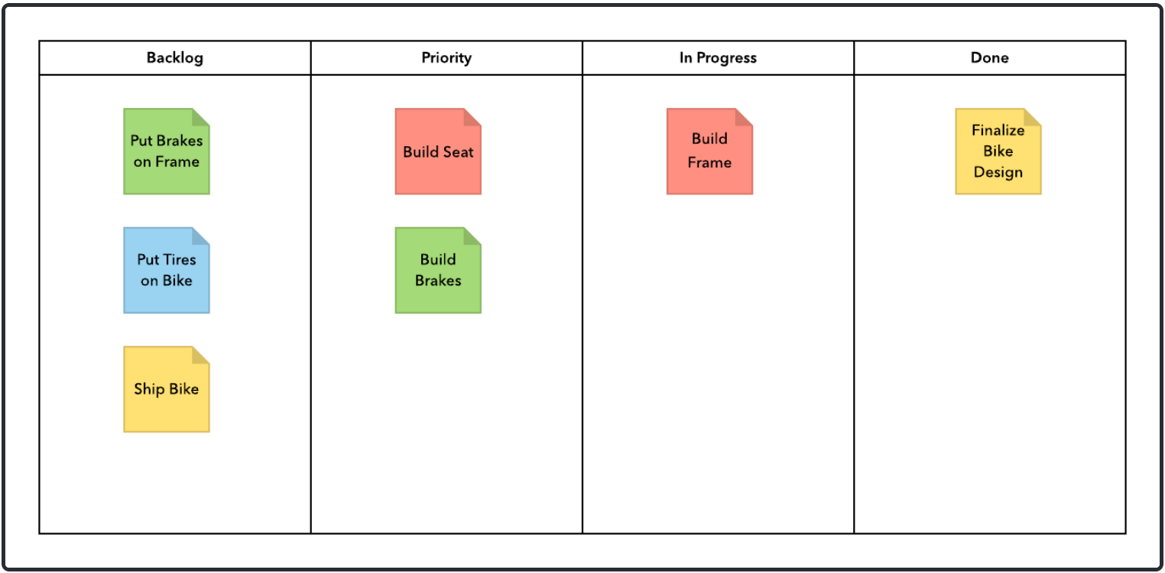
Kanban principles 3 and 4
Principle 3: Respect the Current Process , Roles & Responsibilities
This framework duly recognizes that most organizations already have their own internal frameworks. Everyone also has an ongoing structure which consists of roles, specific responsibilities and job titles.
Principle 4: Encourage Acts of Leadership at All Levels
This was the latest principle being added to Kanban. This part encourages having the ‘power’ to be distributed across the entire team. The Japanese term ‘KAIZEN’ or continuous improvement (CI) was highly encouraged.
Notes:
Principle 3 : Just like the first 2 principles, Kanban does not promote any form of drastic management changes. It was solely designed to promote the slow incremental & logical changes. It actually encourages changes.

Slide 15

Extreme programming (xp)
Proven to be very successful in a lot of corporations and organizations.
It stresses on customer satisfaction and CX/UX. It wants to ‘deliver software as you need it.
Improves a software lifecyle project in 5 ways: communication, simplicity, feedback, respect & courage.
XP practitioners encourages constant communication with customers/stakeholders and fellow programmers.
Keep design as SIMPLE and CLEAN as it could be.
Take pride in its ‘simple rules’ and direct to the point approach on the software development lifecyle.
Can also be used to expand ongoing Scrum or other Agile methodologies.
The ‘rules of XP’ revolves around : Planning, Managing, Designing, Coding & Testing.
The 5 XP Principles are: Rapid Feedback, Assumed Simplicity, Incremental Changes, Embracing Change, Quality Work
Notes:
This is a simply over view of Extreme Programming or XP. This is my Agile framework of choice. I would partner this framework with ‘Pair Programming’. Due to the nature of Worldvizit’s situation, I have concluded that XP with Pair Programming would bring out the BEST results possible, especially if the expected release date is within an 18 month time frame.

Slide 16
Extreme programming (xp) – my recommendation
Upon doing a very thorough review of WorldVisitz’ current situation, as an Agile Consultant & Specialist, I have decided that hands down, the most viable framework is Agile XP ( Extreme Programming).
I’d like to quote the ‘founder’ of the XP methodology, Mr. Kent Beck:
‘XP is a lightweight methodology for small to medium sized teams that are developing software in the face of vague or rapidly changing environments.’
Extreme Programming or XP lives by its 5 Main Core Values:
SIMPLICITY
COMMUNICATION
FEEDBACK
COURAGE
RESPECT

Slide 17

A Deeper Look into xp framework
Simplicity
Reduces the complexities that are non-vital to Worldvisitz app
Minimizing or eradicating features which are non critical
Aims to maximize the value for the project
B. Communication
Stand Up meetings are highly pivotal and flexible
Ongoing Transparency in communications and feedback
C. Feedback
‘Failing Fast’ is encouraged and then further move on for improvement
Every bit of iteration is taken seriously
Every working result is shown

Slide 18
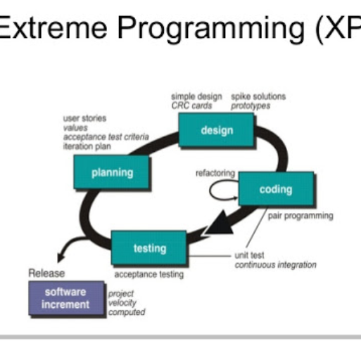
Continuation: a deeper look into xp
D. Courage
Allows a team to bravely tell the truth, the actual situation Is prioritized
Code sharing and communication is highly vital by means of ‘PAIR PROGRAMMING’
E. Respect
Highly encourages professionalism and open communication among team members
Every individual within the team is held accountable
High Importance is given to PAIR PROGRAMMING
Notes:
As mentioned, XP or Extreme Programming has been my choice of Framework for WolrdVisitz. Based on the over-all requirements, the timelines, observing the skill sets of each team member and as a whole, XP would be the super maximal framework. Apart form being a very flexible and dynamic methodology, XP highly focuses has several aspects or ‘ceremonies’ that would further enhance the capabilities of our 4 developers. I would also highly advocate that all 4 developers would have constant communication by using tools like Slack, JIRA and the occassional Zoom meetings. Pair Programming is a ‘ceremony’ of XP that I would highly advocate to our coders. This would not only give them a time to further reflect and observe the code written but also to have an ‘ongoing brainstorming’ while code is being written in an alternating fashion. As early as now, I would also like to mention that near the middle part of the project, I have decided that we should hire 3 external consultants that are highly specialized in the following areas: 1. SQL Development
2. Busines Intelligence / ETL 3. Search Engine Optimization ( SEO).

Slide 19
How agile (xp) solves worldvisitz’ issues & business challenges
1. Ongoing flow of information –> it is very obvious that the current setup of Worldvisitz lacks a lot of transparencies. XP has specific roles which would allow a more open communication
2. Agile XP Ceremonies - > In relation number 1, this would give a more structured approach for the continuity of information flow among the team and keeps everything organized. 2 Examples would be ‘Pair Programming’ & ‘Refactoring’. The former would allow developers to further enhance the current code. The latter would enable the coders to restructure complex & poorly written code.
3. Agile (XP) roles- the roles using this framework are highly applicable to Worldvisitz’ target goal. 2 examples would be the ‘Tracker’ & the ‘Coach’. The first one focuses mostly on developers and also updates the team if he/she notices the process is slowing down. The second also acts as a ‘Chief Architect’ and also acts as a mentor to the less experienced members.
4. XP is non-traditional. It allows updates to happen whenever they are needed. It is non strictly conforming & always adaptable to changes. The roles and ceremonies would definitely prove this point.
Notes:
Agile has a huge difference and advantages over the traditional waterfall. As I have mentioned in the previous slides, Any methodology from Agile is extremely flexible. I’d like to point out the following 4 key components of Extreme Programming or XP that would be highly beneficial for Worldvisitz: 1. Ongoing Flow of Communication 2. Ceremonies of the XP Framework
3. Roles within XP
4. XP is non traditional.

Slide 20
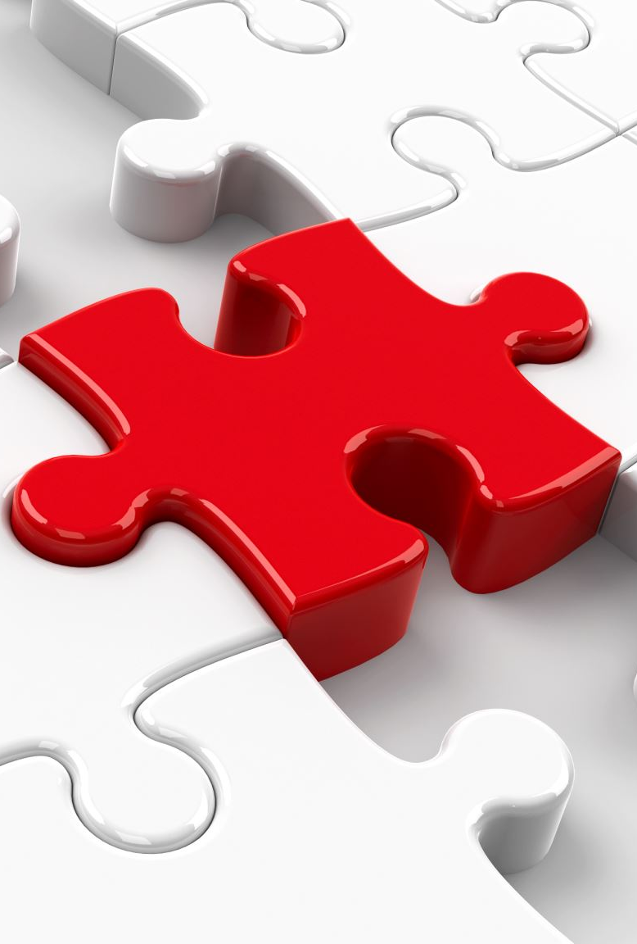
Bonus: scaling agile -> a quick 5 step overview
1. Start with a Minimum Viable Product ( MVP)
This is very vital for early feedback. Also hypotheses could be derived based on the patterns of tracking usage. This step would save the wasted engineering time/efforts.
2. Creating a Product Backlog
Product Managers and Product Owners should maintain 1 full backlog for the whole team. 1 specific backlog lets the Agile coach focus on top priority tasks while, while giving access to all possible contributors to that certain task.
This step prevents miscommunication & further promotes collaboration& information sharing.
3. Create a Culture of Collaboration
Highly recommended to have the Product Owner, Developer(s) & Tester(s) to have their specific meetings. PO expresses the business need, developer discussion architecture & implementation, tester examines potential issues, bottlenecks & other potential issues.
4. Using a Large Scale Framework
Scaled Agile has 3 main frameworks such as: Scaled Agile Framework (SAFe), Disciplined Agile Delivery (DAD) and Large Scale Scrum (LeSS). Each of these have their own specific uses cases and specialized areas wherein they could function better, and giv emazximum results.
5. Be a Lifelong Learner – it is very imperative for most team members to have a mindset of continuous learning. It pays a LOT (figuratively & literally) to have a keen interest or passion for this type of domain knowledge.
Notes:
I’d like to give a very quick 5 step overview of ‘SCALING AGILE’ methodology. For starters, ‘SCALING AGILE’ simply means implementing Agile on a variety of projects, mostly large scale projects. As it states, implementing it ‘AT SCALE’. SCALING AGILE is usually beneficial for extremely large scale enterprises that have ongoing large scale projects. I have made a 4 step outline or overview for scaling agile. These are: 1. Start with an MVP
2. Create a product backlog
3. Create a culture of collaboration
4. Use 1 among the large scale frameworks
5. Ongoing training/ continuing education aka ‘Lifelong Learning’

